Slide 1



FILE SYNCHRONIZATION UTILITY USING OS
CSA0405 -OPERATING SYSTEM OF FILE SYSTEM IMPLEMENTATION
CAPESTONE PROJECT-APRIL 2024
GUIDE BY:
DR. YUVARANI
PRESENTED BY:
K.Mukesh(19221138)
B.Rakesh(192211257) A.Nagachaitanya(192211250)

Slide 2
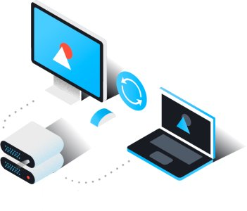
ABSTRACT:
This project aims to develop a file synchronization utility leveraging operating system (OS) techniques. The utility will facilitate the efficient synchronization of files across multiple devices, ensuring data consistency and integrity. Through the utilization of OS functionalities, such as file handling and process management, the utility will provide a robust and scalable solution for users to synchronize their files seamlessly.

Slide 3
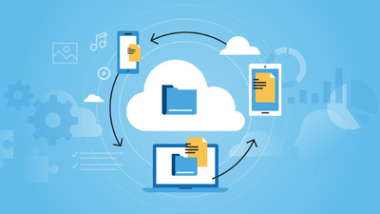
With the Propagation of digital devices and the increasing need for data accessibility, file synchronization has become essential in modern computing environments. Users often work across multiple devices and platforms, necessitating a reliable mechanism to ensure that files remain up-to-date across all endpoints. Traditional file synchronization methods often rely on third-party software or cloud services, which may pose security and privacy concerns. In this project, we propose the development of a file synchronization utility that harnesses the capabilities of the underlying operating system to achieve efficient and secure file synchronization.

Slide 4

Automated Synchronization
Real-Time Monitoring
Efficient Resource Management
Cross-Platform Compatibility
Version Control
Secure Data Transfer
User-Friendly Interface
Error Handling.

Slide 5

Requirement Analysis: Identify the specific requirements of the file synchronization utility, including supported platforms Design Phase: Design the architecture of the utility, including components such as file monitoring modules, synchronization engines, user interfaces, and configuration management. Development: Implement the file synchronization utility according to the design specifications. File Monitoring and Change Detection: Develop modules for real-time file monitoring and change detection using OS-specific APIs User Interface: Develop a user-friendly interface for configuring synchronization settings, monitoring synchronization progress, and managing synchronized files and folders. Testing: Conduct thorough testing of the file synchronization utility to ensure functionality, reliability, and performance across different operating systems and scenarios. Deployment: Package the file synchronization utility for distribution, ensuring compatibility with installation procedures on various operating systems.

Slide 6



ADVANTAGES:
Platform Compatibility
Real-Time Monitoring
Security Features
File System Awareness
User Experience
Vendor Support and Updates

Slide 7


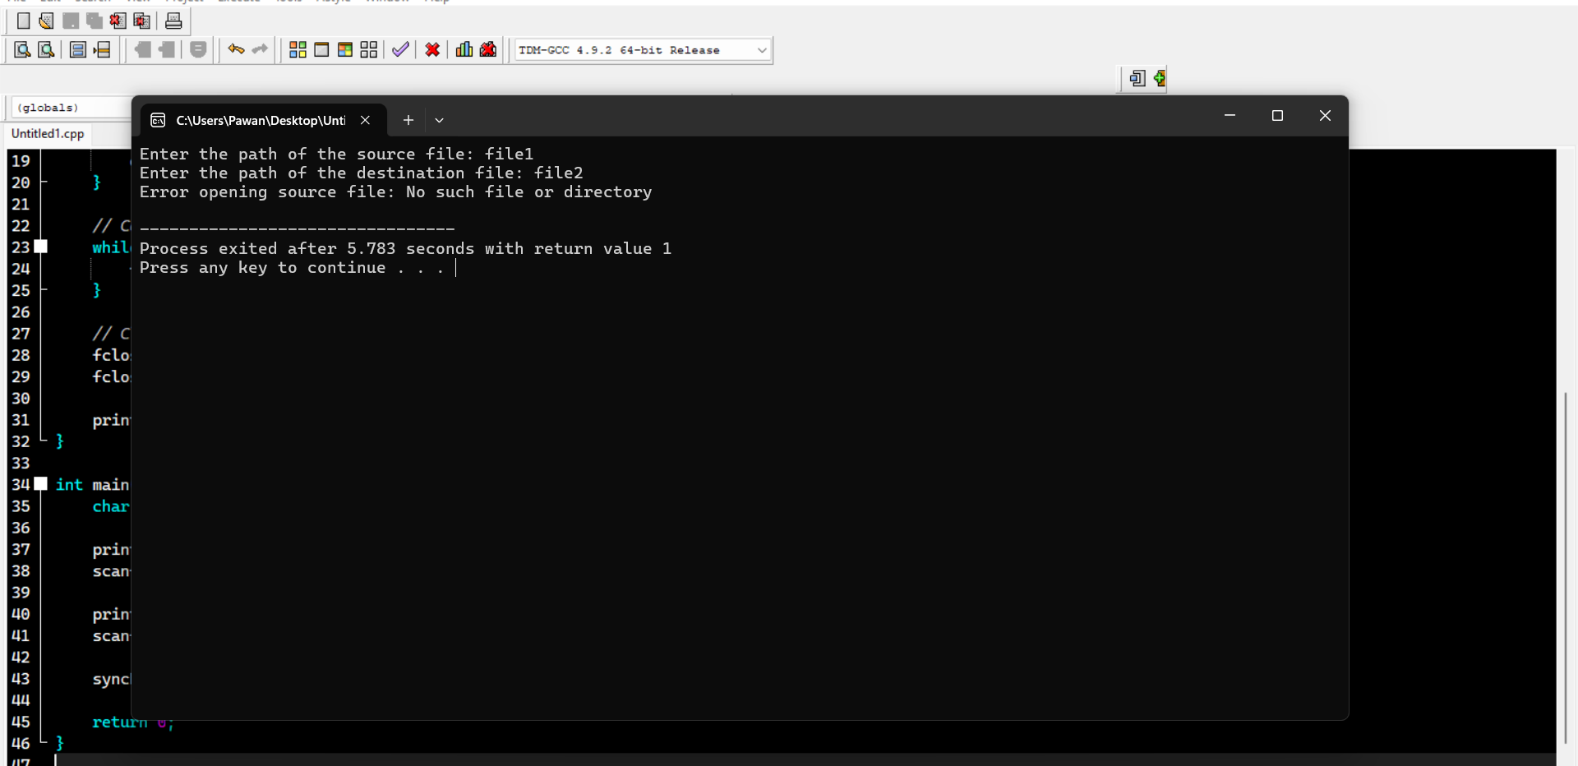

Slide 8




Future scope for file synchronization utilities using OS technologies is dynamic and multi-faceted, with opportunities to innovate, collaborate, and address emerging challenges in data management, security, mobility, and user experience.

Slide 9

.
In conclusion, developing a file synchronization utility using operating system (OS) capabilities offers a wide range of advantages and promising future prospects. Through this approach, developers can leverage the inherent features of OS platforms to create efficient, reliable, and user-friendly solutions for synchronizing files and folders across diverse environments.

Slide 10


